Slide 1
Accommodations 101:
Notetaking
Office of Accessibility
The University of Akron
Simmons 105
Notes:
Welcome to Accommodation 101: Notetaking, presented by the Office of Accessibility at The University of Akron.

Slide 2
Objectives
Participants will:
Gain understanding of notetaking accommodations
Gain understanding of faculty’s role in providing notetaking accommodations

Slide 3
Notetaking Accommodations
Notes:
Today we will discuss the use of a notetaker, a common accommodation that some students with disabilities may receive.

Slide 4

Notetaking Accommodations
Some students registered with the Office of Accessibility have documented disabilities that make it difficult to take thorough notes in class and may benefit from a notetaking accommodation.
Notes:
Some students may have a disability that prevents them from taking thorough notes in class.
Some of these students may benefit from the use of a peer notetaker as an accommodation.

Slide 5
Who is Eligible for a Notetaking Accommodation?
Eligible students may have:
Issues with working memory and/or processing speed
Auditory processing disorders
Sensory difficulties, including hearing and vision
Physical limitations (includes arthritis, neurological disabilities, etc.)
Written expression disorders
Notes:
There are a number of different reasons why a particular student may have a notetaking accommodation.
Some students have trouble with working memory and processing information quickly as it is being presented to them. For these students, they may only be able to write down part of what is being presented, rather than the entire lecture.
Students with auditory processing disorders have difficulty processing incoming information that is spoken, and then writing it down. These students may also only be able to hear and process part of what is being said in a lecture.
Students with visual impairments may take longer to write their own notes, or may miss anything that is written on the board during a lecture.
Other students may have a hearing impairment that prevents them from being able to hear the entire lecture. Some of these students may use Sign Language Interpreters, which requires them to watch the lecture visually, an unable to write notes at the same time.
Some students may have physical limitations that prevent the full use of their hands, thus making taking notes during class very difficult.
Additionally, some students may struggle with a learning disability in Written Expression, where it may take them longer to effectively write down what is needed during a lecture.

Slide 6
Alternatives to Notetaking
Tape Recorder
Copies of Powerpoints
Notes:
Some students may not need a notetaker for a specific class. For these students, they may opt to record each class lecture in order to ensure that they have all of the lecture material.
Other students may simply need copies of any powerpoints that are being used in the class, in order to lessen the burden of writing. These students use the powerpoint as an outline, and then add notes to it as the class lecture goes on.

Slide 7
What is a Notetaker?
A student enrolled in the same class as the student requesting the accommodation, who provides a copy of his/her notes to the student(s)
The Office of Accessibility provides many options and materials for providing notes to students
  Uploading notes to our online accommodation system
  Emailing notes
  Carbon-copy paper
  Photocopying notes
Notes:
If a student requires the use of a notetaker in a class, the Office of Accessibility will work together with the student and the instructor to identify a qualified peer in the class that can provide notes.
A notetaker is another student who is enrolled in the same class as the student requesting the accommodation. They are hired each semester, and assigned for the entire semester. Each notetaker is assigned to specific class, not a specific student, so they may take notes for multiple students enrolled in the same class.
The notetaker and the student work together to determine the options for receiving notes. The Office of Accessibility provides a number of options for providing notes to students, including the ability to upload the notes to STARS, emailing them directly to the student, the use of carbon-copy paper, or photocopying the notes. The Office of Accessibility pays for all of the notetakers copying costs, if needed.

Slide 8
Notetaking- How it Works
Notetakers provide notes to the student for the whole semester
Notes are to be provided within a day or two of each class
Notetaker’s notes are supplemental to student’s own notes
Students request notetaking accommodations each semester
Students can choose in which class(es) they need a notetaker (no labs, seminars, physical education, etc.)
Notes:
Once a notetaker is assigned for a class, they are expected to provide notes to the student with the accommodation for the entire semester. These notes should be provided to the student within 24 hours of the end of class, to ensure that the student has all of the study material needed.
The notetaker’s notes are meant to be supplemental to the student’s own notes, whenever possible. Students should take their own notes, and use the notetakers notes to fill in any gaps in material they may have missed.
Students must request the notetaking accommodation each semester and for specific classes they may need notetakers for. Not all classes may need notetakers, such as lab classes, physical education classes, or field experience courses where few notes are taken during each class.

Slide 9

Benefits of Being a Notetaker
$100 stipend on All Campus Zip Card account for each class assigned as a notetaker
Priority registration
Resume enhancement- notetaker position can be noted on a resume
Gain satisfaction from helping another student
Notes:
The Office of Accessibility encourages all students to consider becoming a notetaker. There are a number of benefits that notetakers receive, simply for copying their own notes.
Notetakers are paid $100 on their ZipCard at the end of each semester for providing notes to the student. Some notetakers are assigned to multiple classes, so they can receive multiple stipends. For example, if a notetaker is providing notes in 4 different courses, they would receive $400 at the end of the semester.
Additionally, notetakers will receive priority registration for an upcoming semester.
Furthermore, notetakers can enhance their resume by including the notetaker position, and can gain satisfaction from helping another student in their class.

Slide 10
Notetaker Recruitment
Recruitment for notetakers begins before the start of each semester
Notetaker Coordinator sends email to class
Faculty assists in notetaker recruitment
Office of Accessibility staff does in-class recruitment by 2nd week of school if no notetaker is in place
Notes:
The Office of Accessibility has updated our notetaking recruitment process in order to make it more efficient. We strive to have as many notetakers assigned before classes begin as possible, and thus begin the recruitment process early.
Once a student’s request has been submitted, the Notetaker Coordinator sends an email to the class roster, asking for volunteers to sign up to be a notetaker.
If no notetaker is assigned before the semester begins, the Office of Accessibility asks faculty to assist in identifying a notetaker in the class, either by reading an announcement or by individually identifying a student who would be a good notetaker.
If the instructor is not able to identify a notetaker, or no one volunteers, a staff member from the Office of Accessibility will come to the class to do a recruitment. These in class recruitments usually begin during the second week of classes.

Slide 11
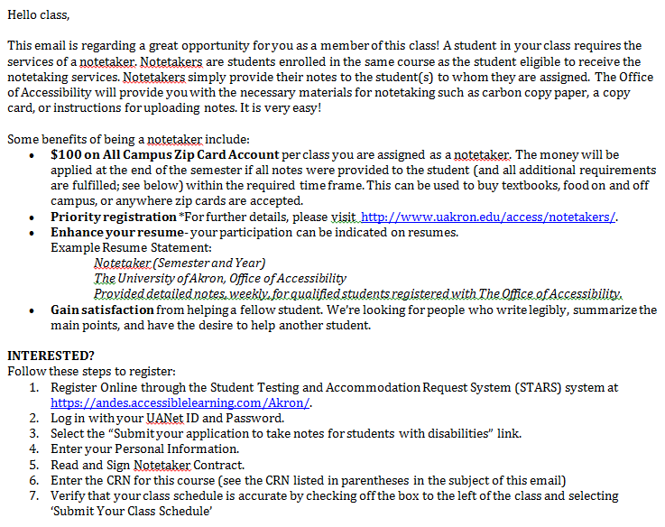
Notetaker Recruitment
1. Notetaker Coordinator sends email to class
Notes:
After a student has submitted a request for a notetaker in a class, the Notetaker Coordinator will then email the class roster asking for someone to sign up as a notetaker.
This email outlines the notetaker position, the benefits of being a notetaker, the registration process for becoming a notetaker, and the terms and condition of being a notetaker.

Slide 12
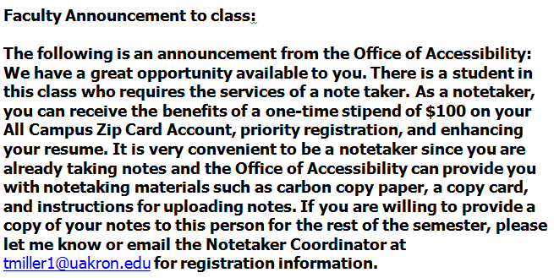
Notetaker Recruitment
2. Faculty Assists in Notetaker Recruitment
Faculty Assistance
  Instructor may identify a good notetaker
  Instructor can provide own notes to student
  Instructor reads recruitment announcement to class
  Ensure that student’s name remains confidential at all times
Notes:
If no notetaker is assigned after emailing the class, the Office of Accessibility will seek assistance from faculty members to help secure a notetaker in the class. The Notetaker Coordinator will send an email to the instructor detailing options for securing a notetaker.
The first option is that the instructor identifies a student who would be a good notetaker during the first weeks of school. Many instructors know their students or get a good sense of students in the first few weeks. Instructors can approach a student they feel may be a good notetaker and ask them to provide this paid service. If the student agrees, the instructor can email the student’s name and contact information to the Notetaker Coordinator so the office can get them signed up.
A second option would be for an instructor to provide their own notes to the student.
The third option is for the instructor to read the provided notice to the entire class, asking for volunteers. If instructors read the announcement, please be reminded to keep the student’s name confidential at all times. Once the notetaker is officially assigned, they will be provided with the student’s contact information. Only the Office of Accessibility, the instructor, and the notetaker should know who the student is that is requesting the accommodation.

Slide 13
Notetaker Recruitment
3. In-Class Recruitment
In-class recruitment usually begins the second week of the semester.
If a notetaker has not yet been identified, a staff member from the Office of Accessibility may be sent to the class to recruit a notetaker in person.
Faculty is notified by email if a staff member will be coming to class.
Staff member arrives 5-10 minutes before class starts to avoid taking up class time.
Notes:
If the instructor is not able to find a notetaker, then a staff member from the Office of Accessibility will come to the class to recruit a notetaker. This process usually begins during the second week of the seemster.
Faculty are notified by email if a staff member will be coming to the class.
The recruitment process typically only takes about 5 to 10 minutes, and at times may be completed before the class session begins.

Slide 14
Notetaker Hiring
Notetaker creates account and registers through the Office of Accessibility’s online system, STARS.
Notetaker completes the Notetaking Training and Quiz that is available on the Office of Accessibility’s website.
Notetaker submits the completed Instructor Verification Form to the Office of Accessibility with a 1-page sample of notes.
Notes:
Once a notetaker has been identified, the notetaker will work directly with the notetaker Coordinator in order to fulfill all of the needed requirements. Notetakers will create an account and register their class in STARS.
They will complete a short Notetaking Training quiz, and they will also submit a completed Instructor Verification Form to the Office of Accessibility.

Slide 15
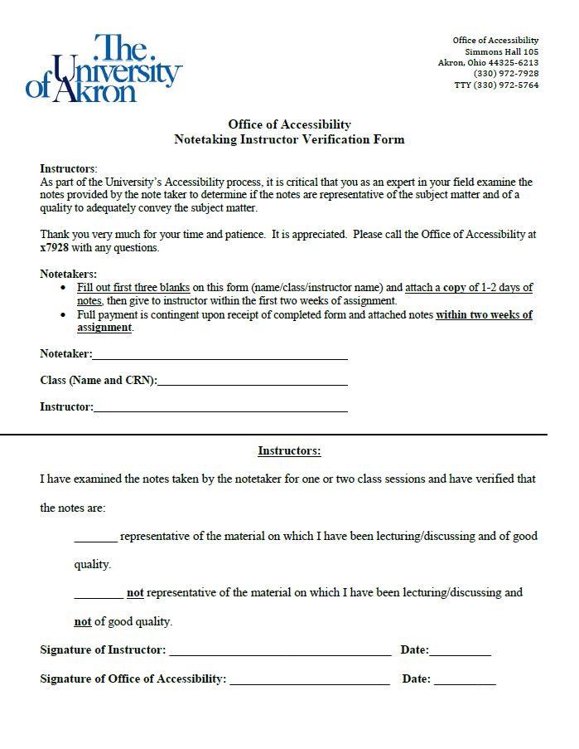
Instructor Verification Form
Notes:
The Office of Accessibility asks instructors to complete the Instructor Verification Form for each notetaker. This form allows our office to verify that the notetaker is providing notes that are representative of class material, as instructors know their course material best. This form only needs to be completed one time at the beginning of the semester. The notetaker should provide this form to the instructor and then bring it to the Office of Accessibility to turn in.

Slide 16
Roles and Responsibilities in Notetaking Accommodations
Student
Notetaker
Office of Accessibility
UA Faculty and Staff
We all must work together to make sure notetaking accommodations are adequately fulfilled!
Notes:
Coordination between the student, the notetaker, the Office of Accessibility, and faculty and staffis essential for the identification of notetakers and making sure that the student receives adequate notes.

Slide 17
Student Roles and Responsibilities
Request accommodations each semester
Speak to instructors about all accommodations, including notetaking requests
Identify possible notetakers in class
Coordinate the delivery of notes with notetaker
Attend each required class session
Take his/her own notes
Notify the Office of Accessibility of any notetaking issues throughout the semester
Notes:
For students, it is their responsibility to request the accommodation each semester. They should speak with the insturctors about their accommodations and notetaking requests.
We ask that students assist whenever possible in recruiting their own notetakers, to make the process more efficient.
Students should work together with their notetakers to coordinate the delivery of notes, and need to attend each class in order to receive the notes for that class period.
Students should still take their own notes whenever possible, and use their notetaker’s notes as a supplement to their own.
It is also the student’s responsibility to notify the Office of Accessibility of any issues or concerns that arise with their notetaking accommodation throughout the semester.

Slide 18
Notetaker Roles and Responsibilities
Complete online notetaker registration
Complete notetaker training and quiz
Submit completed Instructor Verification Form to the Office of Accessibility with 1-page sample of notes
Coordinate delivery of notes with assigned student
Provide notes within 1-2 days of each class session
Notify Notetaking Coordinator of any questions/ concerns
Notes:
Notetakers must complete the entire notetaker registration through STARS in order to be assigned as the notetaker in a class. They must also complete the notetaker training and quiz, and submit a completed Instructor Verification Form to the Office of Accessibility.
Notetakers should work with the student to coordinate efficient delivery of the notes after each class, ideally within 1-2 days of each class session. They should also contact the Notetaker Coordinator of any questions or concerns that arise during the semester.
Notetakers are notified of their responsibilities through the hiring process and the Notetaker Training and Quiz that must be completed.

Slide 19
Office of Accessibility Roles and Responsibilities
Identify students who are eligible to receive the notetaking accommodation
Work with faculty to coordinate recruitment and hiring of all notetakers
Resolve student issues regarding notetaking
Notes:
The Office of Accessibility will identify students who are eligible to receive the notetaking accommodation, and work with them to help them understand the notetaking processes and procedures.
The office will coordinate the recruitment and the hiring of all notetakers.
The Office of Accessibility also works to resolve any issues regarding notetaking that come up during the semester.

Slide 20
Faculty and Staff Roles/Responsibilities
Discuss notetaking options with students requesting the accommodation
Help to identify notetakers in the class as needed
Review notes and sign the Instructor Verification Form for assigned notetakers at the beginning of the semester
Refer any student or notetaker-related issue to the Notetaker Coordinator at the Office of Accessibility
Notes:
The Office of Accessibility asks faculty and staff to discuss the notetaking options with the students who are requesting the accommodations. We also ask for assistance in identifying a notetaker when one cannot be found in the class.
We ask that instructors review and sign the Instructor Verification Form for assigned notetakers at the beginning of the semester. This will help ensure that the student is receiving an adequate set of notes for the class.
We also ask that instructors refer students or notetakers to the notetaker Coordinator if any issues arise regarding notetaking during the semester.

Slide 21
The Office of Accessibility
values collaboration between you, your students
and our office. Thank you for your time and participation.
Office of Accessibility
Simmons Hall 105
330-972-7928
www.uakron.edu/access
If you would like an electronic copy of this presentation, please feel free to contact the office at access@uakron.edu.
Notes:
Please feel free to contact the Office of Accessibility’s Notetaker Coordinator with any questions or concerns about the notetaking process.

Slide 22
Accommodations 101:
Notetaking
Office of Accessibility
The University of Akron
Simmons 105
www.uakron.edu/access

